Slide 1
Lab 1

Slide 2
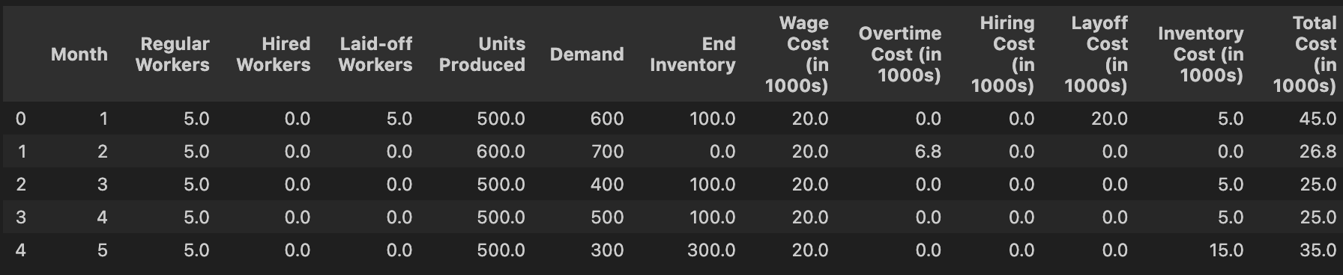
Production Policy
Recommandation : Strategy mixed
Total cost : 156.8
Only use over time in February

Slide 3
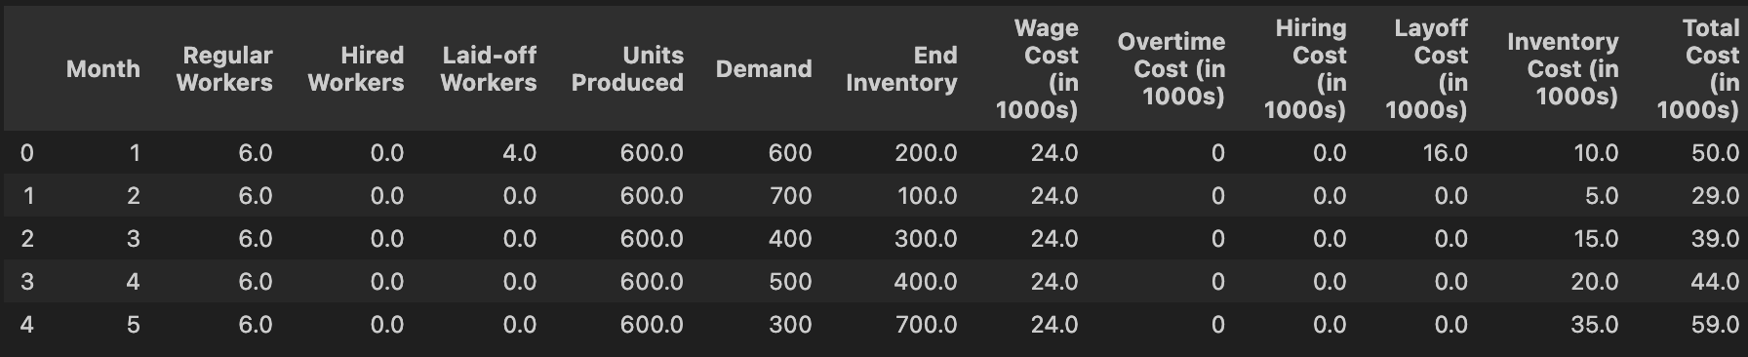
Comparaison
Strategy 1 : Level,
Hypothese: always have enough to answer the demand
Total cost: 221

Slide 4
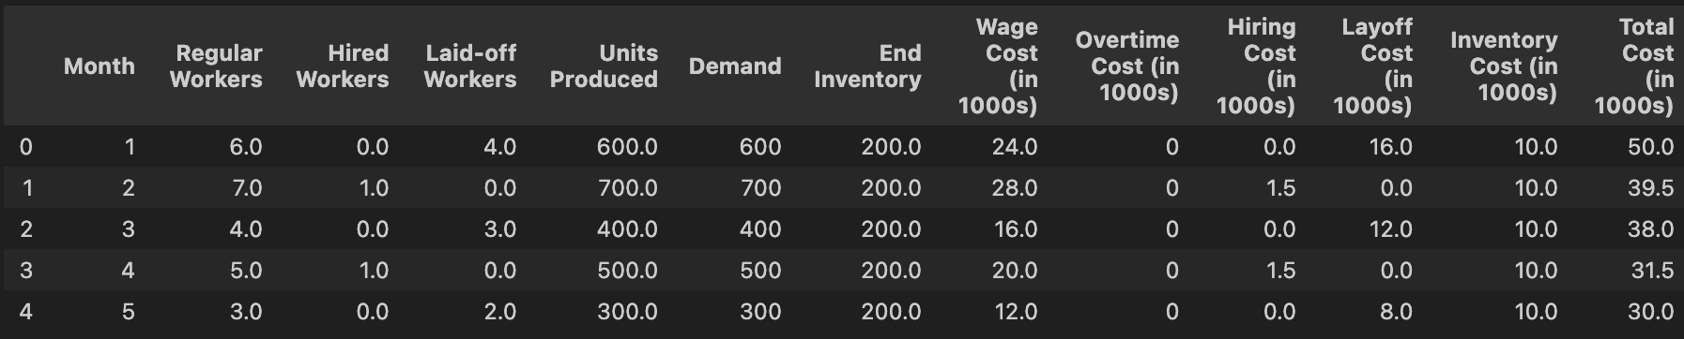
Comparaison
Strategy : Chase
Total cost: 186.00

Slide 5
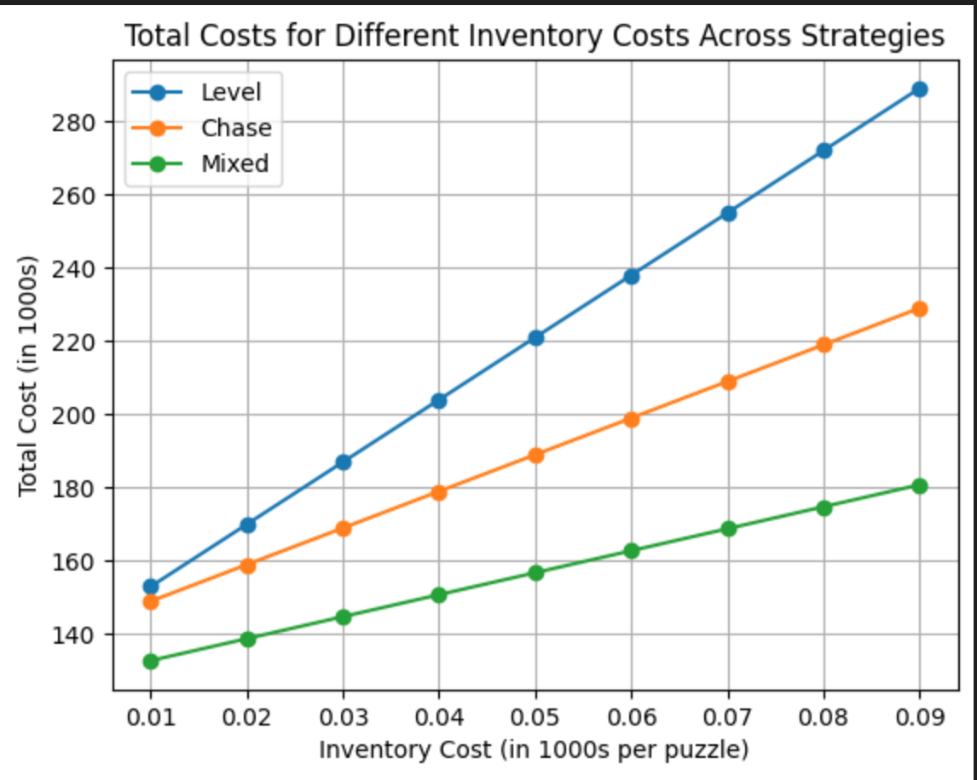
Sensitivity analysis

